Slide 1




Face Detector Using Deep Learning
By : Aishah Alanazi, Hala Alenazi, Hussain Alsultan
Yaqeen Alhawaj and Shaikha saud.

Slide 2

DATA
01
02
03
Backstory
Data set
Tools
Data Processing
MODELS
Baseline model
Convolutional Neural Network Model
Transfer Learning model
DEMO
Challenges
Future Work

Slide 3
BACKSTORY
Deep learning is now more accessible than ever before for organizations of any size. Face recognition is a biometric system used to identify or verify a person from a digital image. Face recognition is one of the most used methods in the field of image analysis.
The goal of this project is to build a deep neural network model that uses image data to extract its features and then recognize it, regardless of lighting, expression, illumination, ageing, transformations (translate, rotate and scale image) and pose, which is a difficult task, this project can be used for Security cameras, Offices, University, ATM, Bank, in any locations with a security and to collect criminal's images automatically and notify the authorities.

Slide 4
DATASET
Facial Detector
Data from Kaggle.
There are 105 celebrities and 17534 faces.
Data Sample 9 celebrities and 1489 faces.

Slide 5









TOOLS

Slide 6
PROJECT WORKFLOW
DATA READING
DATA AUGMENTATION
Reading images using
TensorFlow
Resize images
Scaling
Flip images
Rotate Images
BASELINE MODELS
MODELS
Sample images.
Data classes graph.
CNN Model
Transfer Learning

Slide 7
DATA AUGMENTATION
Train
Validation
Test
Resize the images (180x180)
Scaling/Normalization (1 to 255)
flip images (Horizontally)
rotate images (up to 20°)
90%
5%
5%

Slide 8
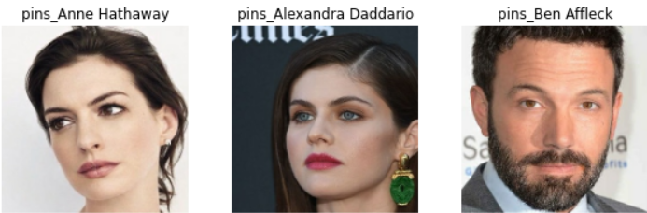
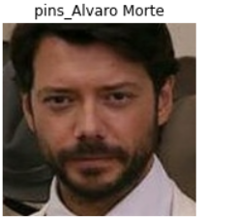
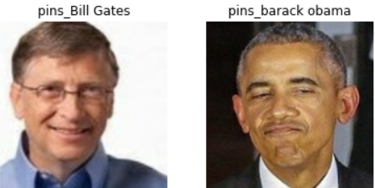

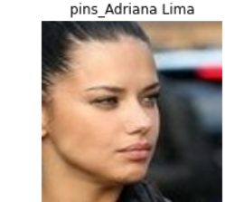
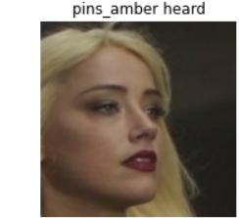
DATA SAMPLE

Slide 9
BASELINE MODELS
Model | Simple NN | Neural Network | Simple CNN
Training | 0.416 | 0.392 | 0.468
validation | 0.457 | 0.396 | 0.493

Slide 10
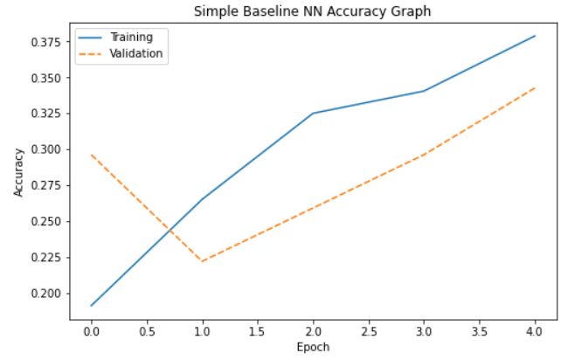
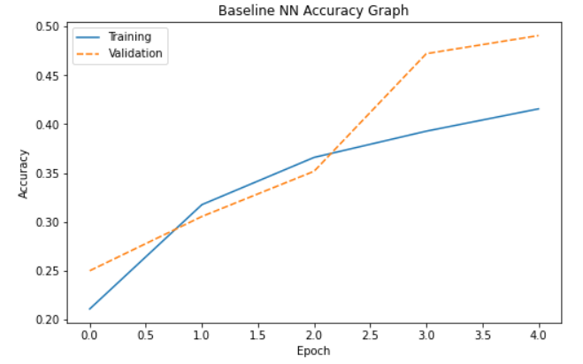
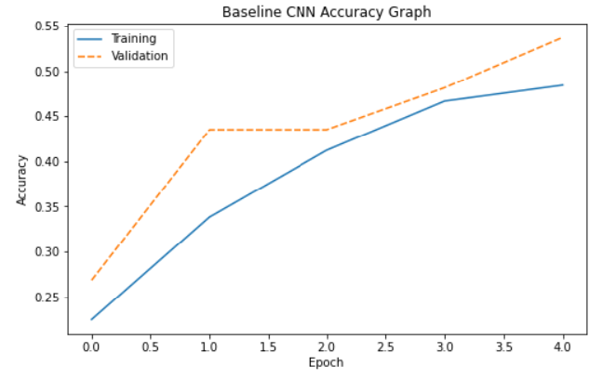
BASELINE MODEL GRAPHS
Simple NN
Neural Network
Simple CNN
Epochs =5

Slide 11
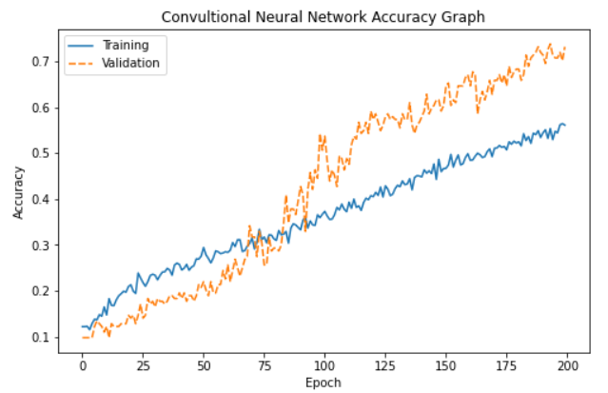
Convolutional Neural Network Model
Model | CNN
Training | 0.733
validation | 0.731
Epochs =200

Slide 12
Transfer Learning Models
Epochs =30
Model | DenseNet | VGG-16 | VGG-19
Training | 0.769 | 0.953 | 0.969
InceptionV3
0.874
ResNet50
0.546
validation | 0.792 | 0.932 | 0.926
0.829 | 0.231

Slide 13
Demo
Using openCV library for the demo, we were able to simulate it in real life situations

Slide 14
Challenges
It was easier for us to find out the identity of subject however it was pretty difficult to identify human identity.
The model takes long time to run .
The demo was able to identify the face for the video at the end, but it took long time.
Difficulties during the past few weeks due to Covid-19.

Slide 15

Future Work
refine our model to be faster and more efficient.
use it for collecting violations in public places.
increasing the number of people detected per second.
using multiple models to gain different types of information ( for example: detect identity, car, clothing, smoking, crowded streets, Weather, time of day).

Slide 16

THANKS!

